Slide 1
Information and Communication Technologies (TCI)
Presented by Benmakloufi Zohair
USTHB University
Academic Year 2025–2026

Slide 2
1- What is TIC?

Slide 3
Information and Communication Technologies (ICT) refer to the set of technologies used to create, store, process, and exchange information.
ICT combines computing, telecommunications, and digital media.

Slide 4
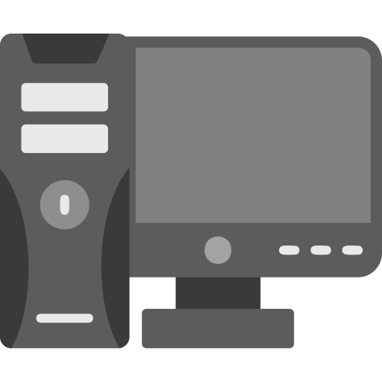
2- Components of ICT
ICT systems are composed of several interconnected components that work together to process and transmit information.
Hardware includes physical devices such as computers, servers, smartphones, routers, and printers.
Software includes operating systems, applications, and development tools.
Networks allow devices to communicate through the internet, LAN, or wireless technologies.
Data represents the information being processed, such as text, images, audio, and video.

Slide 5

3- Importance of ICT
Fast communication
Increased productivity
Online education
Digital business and healthcare

Slide 6





4- Google Services
Google Cloud Platform
Google Drive (cloud storage)
Gmail
Google Docs, Sheets, Slides

Slide 7







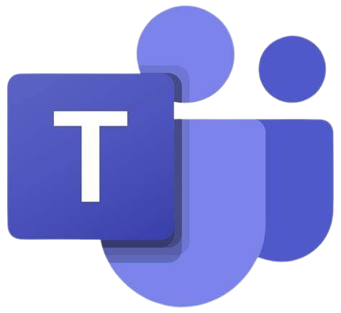
5- Microsoft Tools
Microsoft office :
word
excel
powerpoint
Microsoft Teams and Azure
OneDrive cloud storage
Windows Operating System

Slide 8


6- Git and GitHub
Git | GitHub
It is a software It is installed locally on the system It is a command line tool It is a tool to manage differnet versions of edits, made to files in a git repository It provides functionalities like Version Control System Source Code Management | It is a service It is hosted on Web It provides a graphical interface It is a space to upload a copy of the Git repository It provides functionalities of Git like VCS, Source Code Management as well as adding few of its own features

Slide 9
7- Other ICT Technologies
Cloud Computing
Artificial Intelligence (AI)
Internet of Things (IoT)
Cybersecurity

Slide 10

8- Advantages of ICT
Fast communication
Global connectivity
Automation
Easy access to information
Enhanced learning opportunities

Slide 11

9- Disadvantages of ICT
Security risks
Privacy issues
Digital addiction
job diplacement due to automation
health issues
dependence on technology

Slide 12
10- Conclusion
ICT is essential in modern life
Improves efficiency and communication
Will continue shaping the future

